Slide 1
Visualizing Data What, Why, and How to Start
Notes:
Welcome to our presentation on Visualizing Data.

Slide 2
Goals of the Presentation
You will learn:
What makes a data visualization
Why they can be effective
How to plan
Notes:
Our goals for Part One of the presentation are to teach the basics of data visualization or “data viz” as we will call it. You will learn the definition of data viz, why they can be effective to communicate information, and how to plan for one. Part Two of this presentation will review useful design tips for data viz and some suggested tools you can use to make them. After listening to the two parts, we hope that you can create compelling data visualizations on your own or direct a designer to help you achieve your data viz goals.

Slide 3
WHAT IS
DATA VISUALIZATION?
Notes:
So our first question to answer is what is data visualization? Let’s see what people here think.

Slide 4
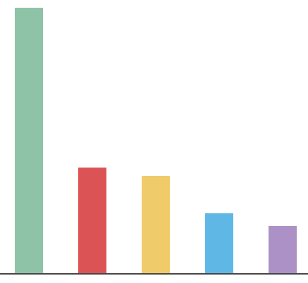

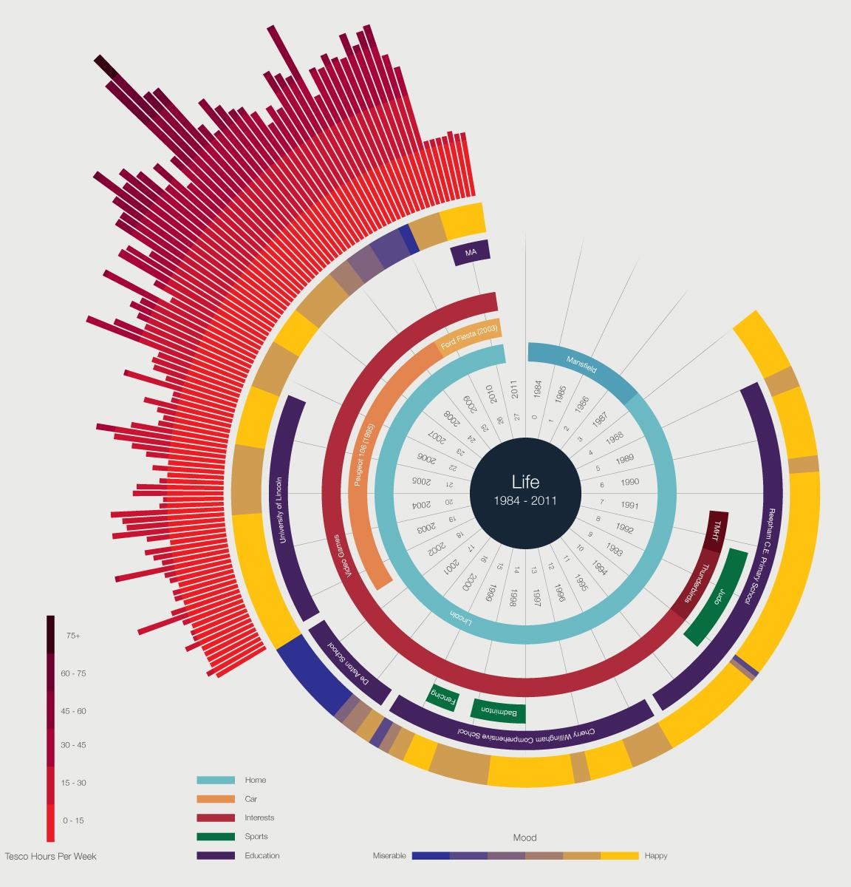
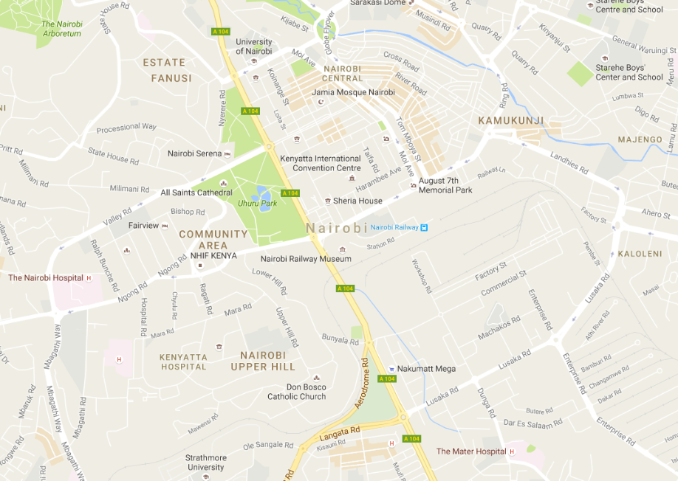
Name the Data Visualization
58%
George Patterson, The Noun Project
Map data © 2016 Google
© Ben Willers
Notes:
These are four examples of graphics that may or may not be considered a data viz. I will preface this by saying the answer to what is a data viz will not always be clear. For the first one, this bar graph, please raise your hand if you think this is a data viz. Now raise your hand if you don’t think so. Is anyone unsure? Does anyone want to explain why they thought yes or no? Generate responses. Do the same for next three examples, but proceed quickly. Note that we will offer our opinion on what is/is not data viz on slide 7.

Slide 5
“Nicely designed posters with a few numbers on them aren’t really data viz.”
– Amanda Cox
Editor of Upshot, New York Times
Notes:
This is a quote from Amanda Cox, who does a lot of data viz work at The New York Times (which is a good place to look for examples, by the way). “Nicely designed posters with a few numbers on them aren’t really data viz.” This quote nails one thing that you MUST have to be a data viz, and that is NUMBERS. But as Amanda points out, you need more than numbers.

Slide 6

Defining the Medium
Data visualization: A nontext- based representation of data that enhances the understanding of that data.
Martha Ormiston, The Noun Project
Notes:
There are a lot of definitions for data viz floating around out there, but we’d like to propose the following one. We define data viz as a nontext-based representation of data that enhances the understanding of that data. By “nontext” we mean something other than a set of words or numbers/numerals. You’re taking numbers and turning them into something visual so that you are able to learn something more clearly about those numbers.

Slide 7
Name the Data Visualization (Revisited)
58%
George Patterson, The Noun Project
Map data © 2016 Google
© Ben Willers
Notes:
Based on our definition, let’s discuss these examples once more. The first one is your standard bar chart, which is one of the most basic type of data visualizations out there. When you take numbers and graph them with bars or lines, you’re seeing something other than text that explains what’s happening with those numbers, so that would be considered a data viz. But some of you may be looking closely and thinking, but this chart doesn’t have any numbers! Correct. We would need to add more information here for this chart to actually be a data viz… namely, the data. And labels. But we’ll get more into that later.
The second example may be a bit tricky. The thumbs up icon is a type of visual, but it’s not actually saying much about the number except that this 58% is a good thing. We would argue this icon doesn’t really turn the value of the number into anything visual, meaning you aren’t seeing 58% in a form that’s not text. Based on our definition, we’d say this example is not a data viz.
The map on the bottom left is pretty standard. It has roads, buildings, and names of places labeled, but no numbers. If we think about it, a map intrinsically contains data about distances between places so that your mind can perceive those distance numbers accurately. So we would argue that maps are data visualizations.
This last example may be what one typically thinks of when they hear “data viz.” It’s a really complicated-looking graph with a bunch of colors and geometric shapes. Yes, this could definitely be considered a data viz. But we’d also want to look more closely at it to make sure it does an effective job of communicating what these numbers mean.

Slide 8
Data Visualization vs. Infographic
These terms are sometimes used interchangeably.
Just remember: You need DATA plus a visual representing the data to make a data viz!
Notes:
“Infographic” is a term often used interchangeably with “data viz.” You’re going to find a lot of opinions out there on what constitutes a data viz versus an infographic. Just remember, for anything called a data viz, you need DATA. And not just data. You need the graphic or illustration or visual to make the data easier to understand, not just arrange the data nicely on a screen. Many infographics do not, in fact, include data.

Slide 9
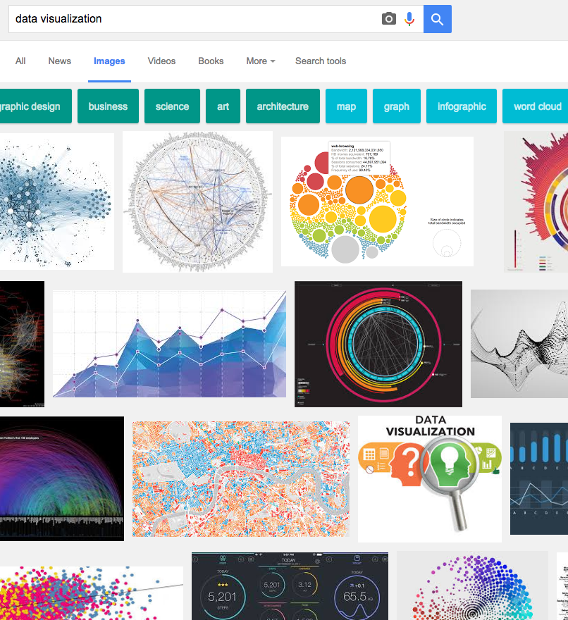
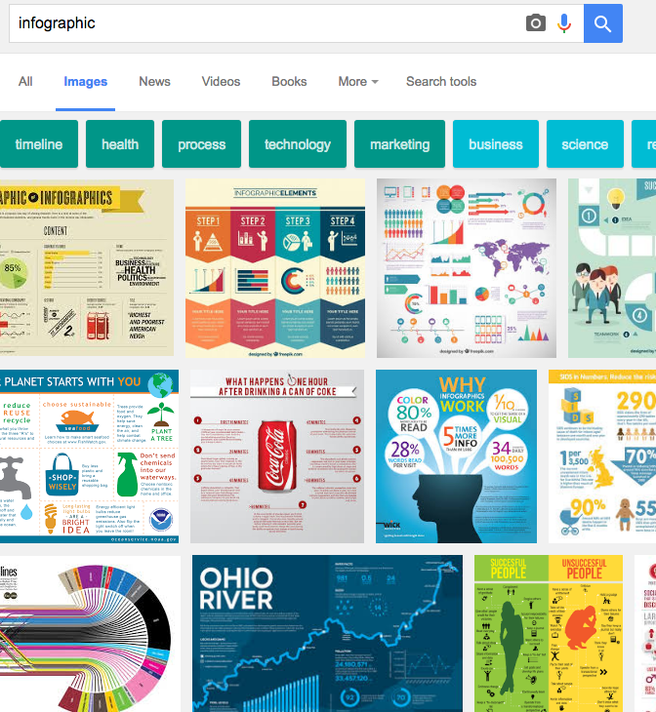
What Google Thinks
Graphs, geometric shapes, color coded, number driven
Collection of facts, icons, pictorials, text driven
Notes:
If you ask Google what a data viz is and what an infographic is, these results are what will come up. For the most part, we can see on the left that the term ”data viz” is more associated with graphs, geometric shapes, color-coded elements, and numbers. On the right, we see that “infographic” means something a little different. These examples are more like collections of facts arranged nicely with icons, pictorials, and numbers sprinkled throughout. They tend to use a lot more text in order to tell a story about a topic. Certainly, some of these infographics could include data viz examples within them, but on the whole, they look different and are more editorially driven.

Slide 10

Example of infographic
© Expedia.ca
Notes:
Here is an example of what would classically be called an infographic. It includes different sections that explore subcategories of the topic. (Click) One of the sections even has a little data viz in it—a modified pie chart. (Click) But then we see another section that doesn’t have any data visualized. It’s just text that lists out facts. The style of the design is typical for infographics (nowadays). It offers a lot of little icons and pictures to draw your eye, not because they have anything to do with data, but because they are visually appealing.
Also note that this whole thing is meant to be read in order, starting with “Why Vacation Time is Good…” and then “…For a Smarter Brain”, followed by “...For the Mind/Body Connection.”

Slide 11
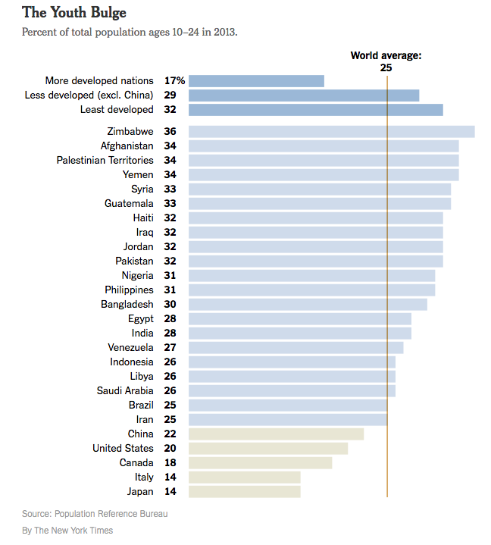
Data visualization example
Notes:
Here’s a data viz. Its main purpose is to show how these numbers relate to each other in size. There is much less text here. Your eye is simply drawn to the lengths of the bars. In this example, we can see the percent of a country’s population between the ages of 10 and 24. The vertical line shows the world average is 25 percent, so you can tell which countries are above or below the average. The variation in the color of the bars helps you quickly see that the top section is regions and the bottom section is countries below the world average.

Slide 12
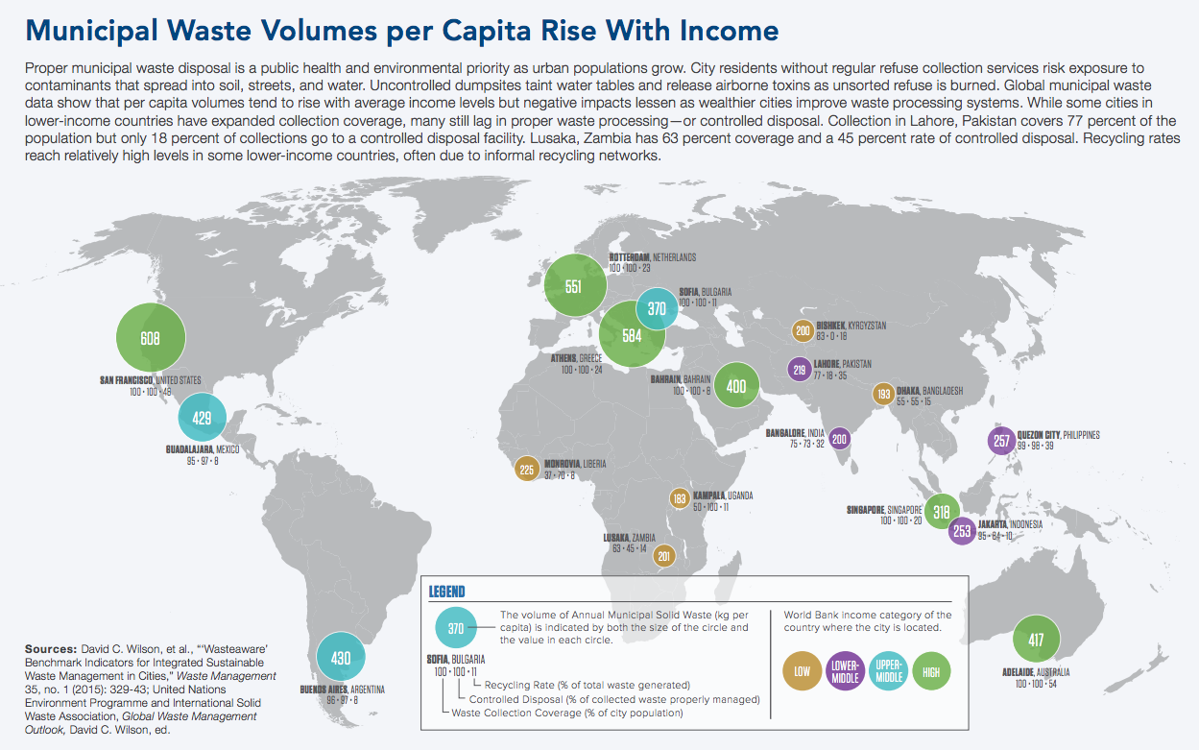
Data visualization example 2
© 2016 Population Reference Bureau
Notes:
Here’s another data viz. This example shows how municipal waste increases when cities have higher incomes. The bubbles are sized proportionally according to the volume of waste and color coded to show relative income level. Now here, we do have more text, so we’re not excluding text as a possible component of a data viz. But the main focus here is the map, which makes the data visual through the location of the numbers on the map, the size of the shape they are on, and the color.

Slide 13
“[I emphasize] visualizations that do some work; they persuade, they explain, they explore. Beauty is desirable, but I’m not excited by pretty charts that are also pretty useless.”
– Graham Wills, Data Science and Visualization Expert at IBM
Notes:
Here’s another quote, this time by Graham Wills at IBM that I hope helps with our definition. “I emphasize visualizations that do some work; they persuade, they explain, they explore. Beauty is desirable, but I’m not excited by pretty charts that are also pretty useless.” So again, the idea is that data viz is doing more for us than looking pretty.

Slide 14
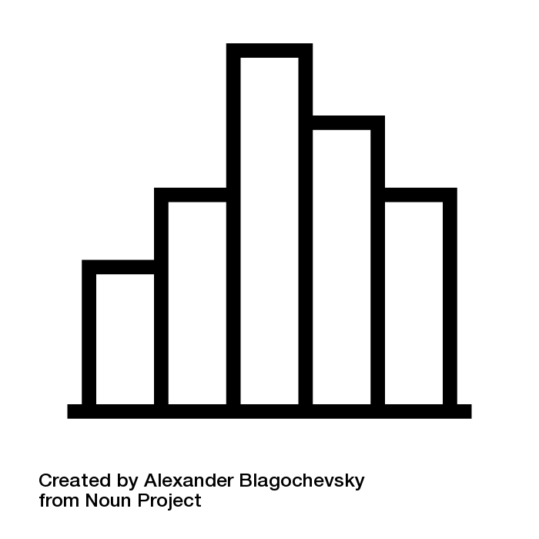
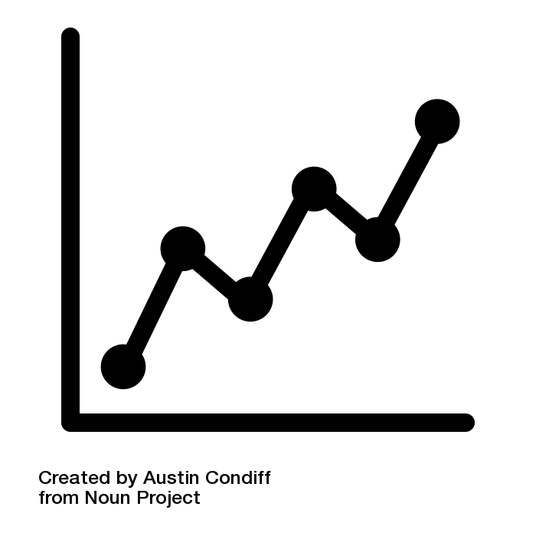
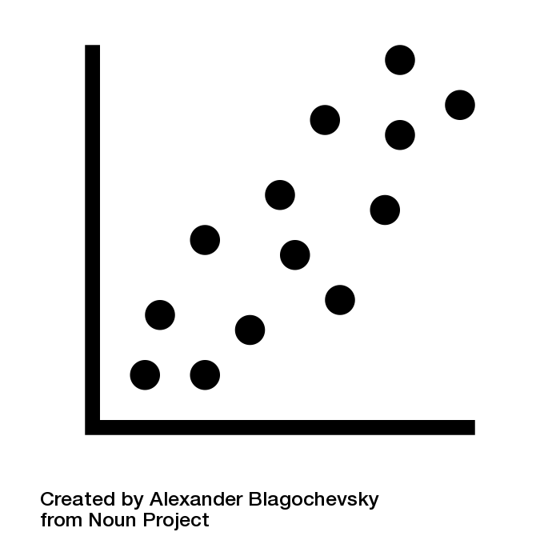
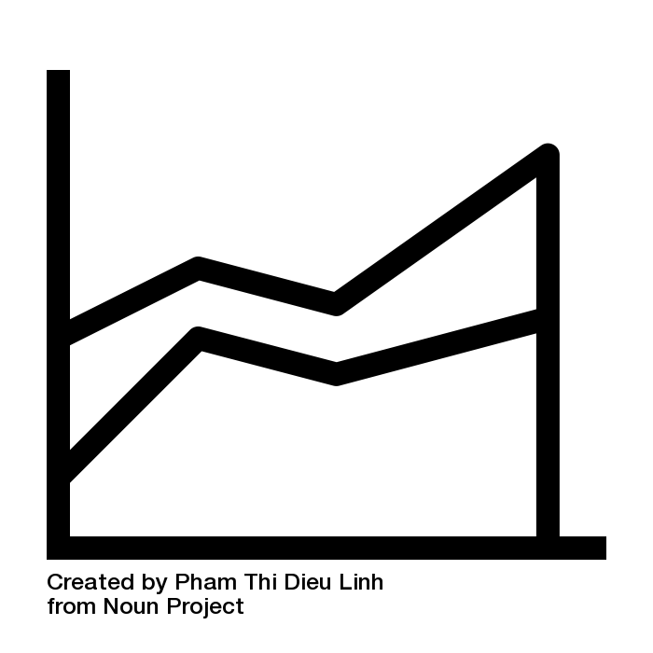


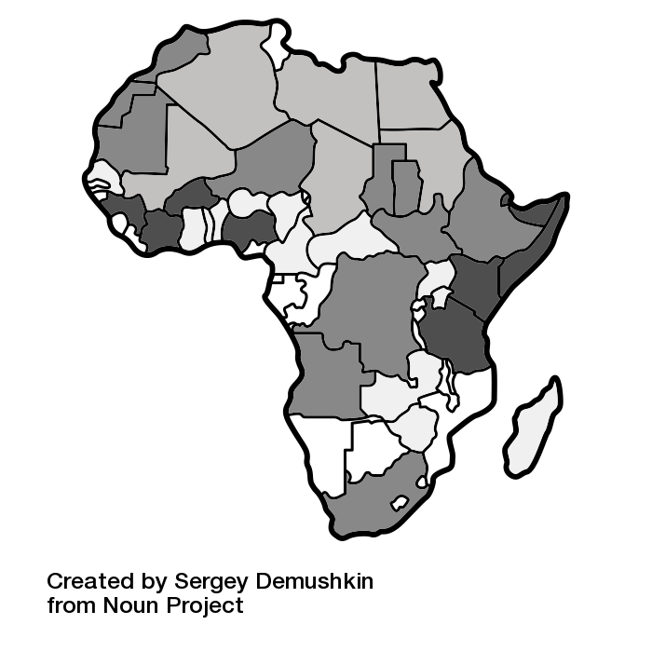
Basic Data Visualizations
Bar chart
Line chart
Scatter plot
Area chart
Pie chart
Bubble chart
Heat map
Alexander Blagochevsky, Austin Condiff, Pham Thi Dieu Linh, Yohann Berger, Sergey Demushkin, The Noun Project
Notes:
Here is a list of some of our basic data visualizations. And yes, they are what we’ve traditionally called graphs or charts. Some of you probably already have a lot of experience in data viz because you’ve created lots of graphs! Each one is good for showing a particular type of data set. For example, a line chart displays change over time. An area chart does the same, but can also show volume.

Slide 15
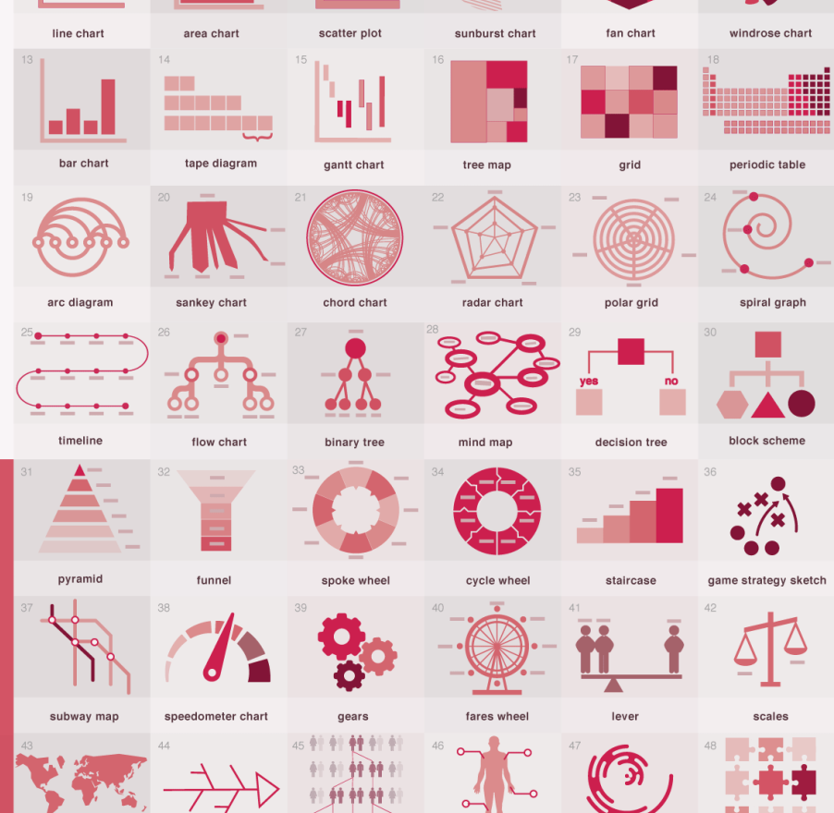
Other types
© Anna Vital
Notes:
But with data viz, we can expand our universe of what we can do with numbers to make them more understandable. The possibilities of how to present data in a visual way are really endless. But although the possibilities are endless, not every possibility is a good one. And more complex visualizations are not inherently better.

